Slide 1
System Block Diagram
Seat belt status
CAN I/P
Occupant Classification
(Processed data stored in Memory)
HW O/P
HW I/P
Faulty status if input CAN message is missing
SW3 and SW4 combination
HW O/P
SW3, SW4:
00 : Child : Lamp ON
01 : Adult 95% : Lamp OFF
10: Small adult : Lamp blink every 5 sec
11 : Empty : Lamp blink every 10 sec
Occupant status
CAN O/P
Passenger Airbag Disable/Enable
Warning lamp

Slide 2
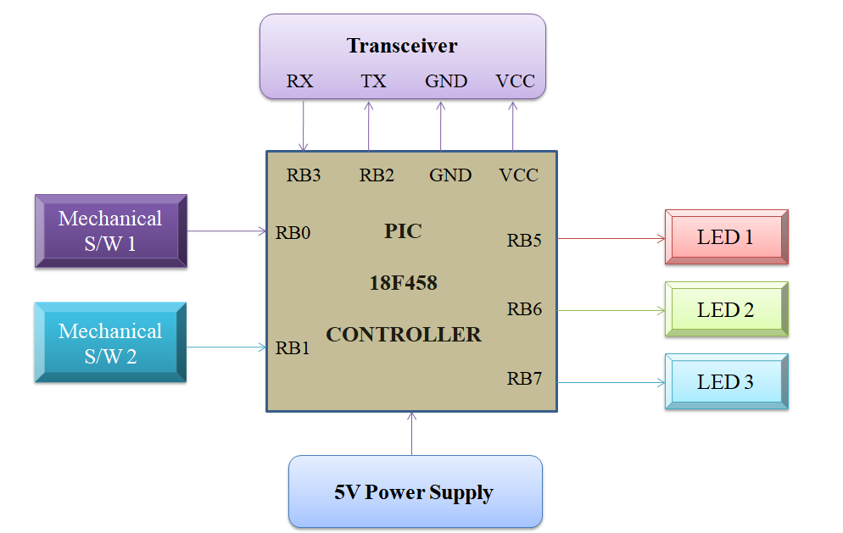
Hardware Block Diagram

Slide 3
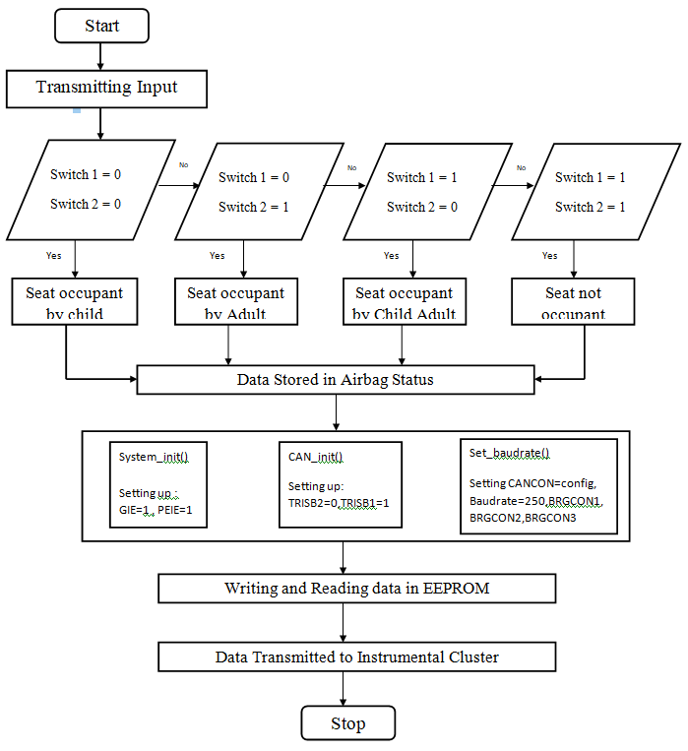
Sequential Flowchart

Slide 4
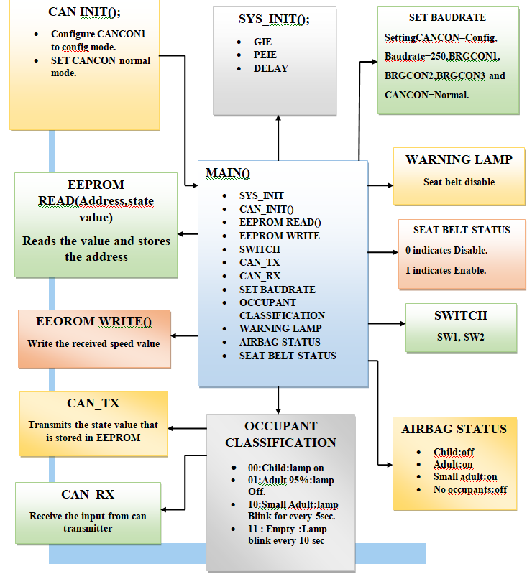
Functional Block Diagram

